Slide 1
Comprehensive Outcome, Research, and Evaluation (CORE) Reporting System

Slide 2
What is CORE?
Comprehensive Outcome, Research, and Evaluation Reporting System
Centralized, web-based system
Participant-level data collection
Not specifically case management system
Free for use by TAD funded and non-funded treatment courts and diversion programs
Goals:
Useful for sites
Meet evaluation, performance measurement, & related needs
Notes:
Not case management system in that it does not have individual case notes per session, no scheduling functions, no payment/fee tracking

Slide 3
Expectations
Emphasized in WI Standards and National Standards
Data collection and evaluation are a required aspect of the TAD program
48-hour entry
Notes:
Data collection and program evaluation are both addressed in state and national standards for tx courts and diversion programs
All TAD funded programs are required to enter all referrals to their program regardless of admission to the program

Slide 4
Expectations TAD funded programs
Tracking data for evaluation and performance measures
Drug and Hybrid Treatment Courts
Veterans Treatment Courts
OWI Treatment Courts
Mental Health Supplement
Diversion Program
Program outputs and outcomes
Current information on program performance
More event-level data collection
Valuable for sites on-going
Notes:
Outcomes (admission and dc) particularly for evaluation
Progress updates for performance measures for site use to evaluate program performance (ratio of incentives and sanctions, number of treatment sessions attended etc)

Slide 5
Security
Web browser options
Chrome
MOU and data sharing agreement
Sensitive data….
Participant consent forms
Sites can only view their own data
Notes:
Every site(county/tribe) needs to have a MOU with DOJ given the sensitivity of the data collected such as criminal justice and treatment information – Updated MOU is required every 3 years with next updated year being 2026???
Participants need to be signing consent forms to have their data collected- is a checkbox in core for that
Can only view data for the specific site-program combination you have requested access to

Slide 6
List of programs
Can provide a specific program name to accommodate the various options in use by individual counties
Notes:
If you are going to change program let us know! For example, if you are a drug court or OWI court and will become a hybrid court

Slide 7
Security-Roles
Site Admin – Provides overall management of CORE access, entry, and data quality at the local (county/tribe) level for one or more programs. Site Admins are responsible for requesting, monitoring, and approving user access and use of the system for the county/tribe. Site Admins have full access to CORE to enter and update data and run reports. One site admin per county/tribe. Site Admins may also function as the Program Admin and/or Program User.
Program Admin – Oversees the entry and data quality at the program level for a particular program. Program Admins are responsible for submitting user requests to Site Admins and for monitoring user access and use of the system at the program level. Program Admins have full access to CORE to enter and update data and run reports. One Program Admin per program per county/tribe. Program Admins may also function as a Program User.
Program User – Enters and updates data in CORE for a particular program. There may be multiple program users per program per county/tribe.
Report User – Has the ability to run assigned reports in CORE, but cannot edit individual-level data.
Notes:
One site admin per county/tribe- needs approved by same individual who signed MOU for your site (county exec/board chair), will sign off on all requests
One program admin per program- will sign off on all requests for that program
As many program users and reports users as youd like

Slide 8
Security
Requesting new user access
Don’t share usernames and passwords!
Management control agreement for 3rd party, non-criminal justice agencies
Changing user roles
Remember Removal Request Form
Site Admin changes require Authorized Representative signature!
Deactivating users
This is a responsibility of the sites!
Notes:
Complete a user request form
Complete user agreement
MCA if needed
Remove user form

Slide 9
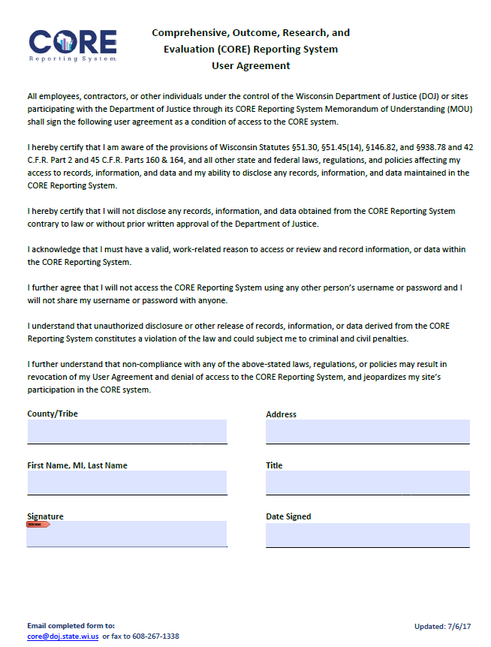
User Agreement Form
Notes:
User agreement- don’t share password, disclose information etc

Slide 10
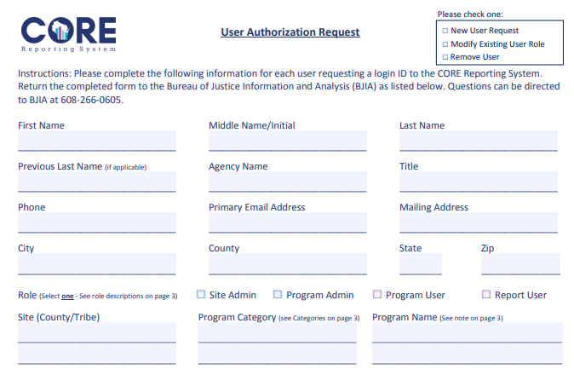
Requesting New User or a Change Form
Notes:
New user request form or modification form

Slide 11
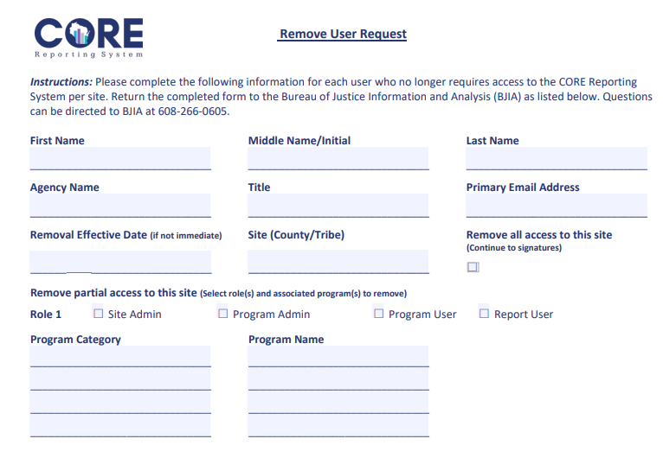
Deactivating Users Form

Slide 12
Security
Username and password
After request, will be emailed username and temporary password
Must change within 72 hours
Multi-factor authentication
Will be required to set up upon first login
What to do if you get locked out (and how to prevent it)
Notes:
Next 2 slides show MFA setup

Slide 13
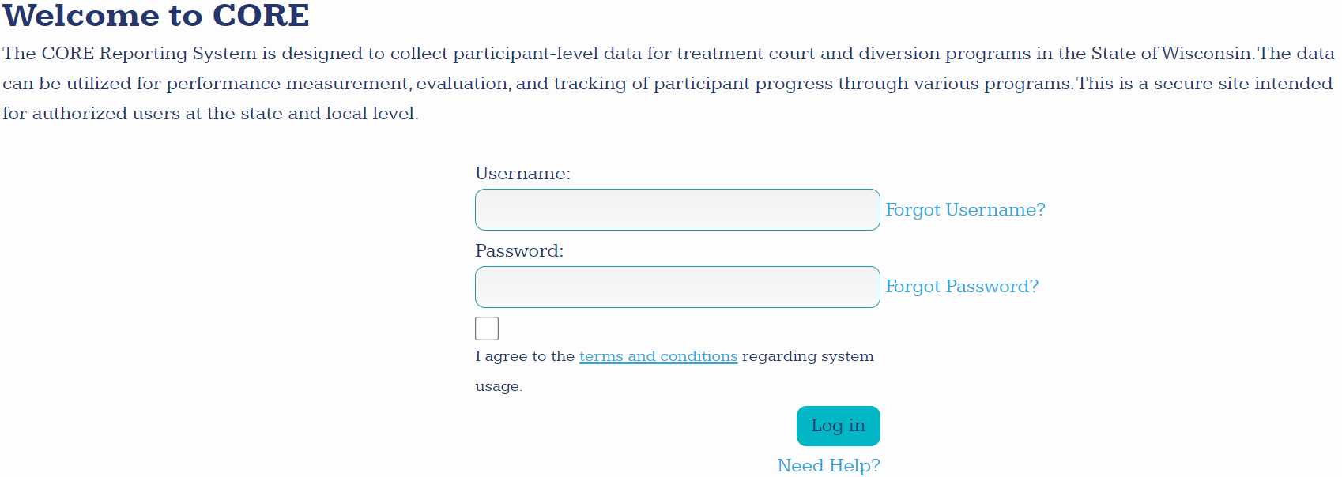

Slide 14
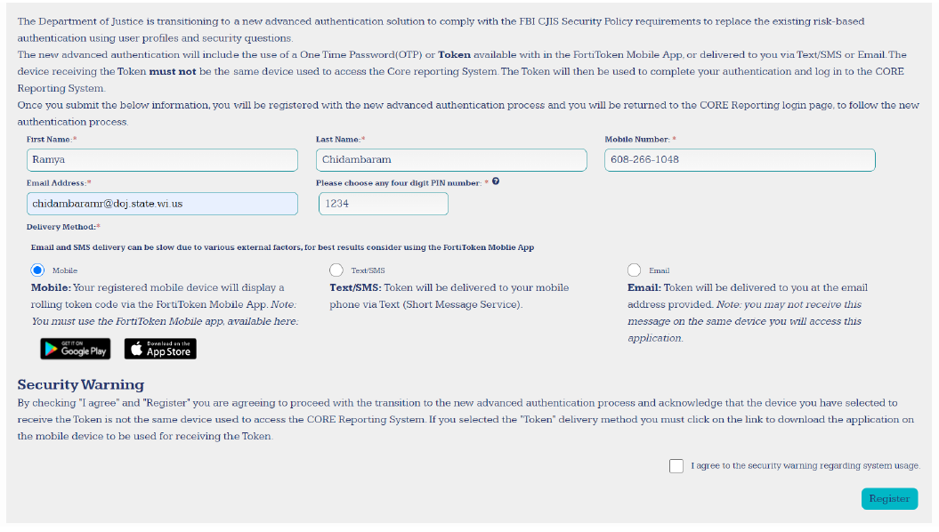
Notes:
Highly suggest using the mobile app if you are able

Slide 15
Data Collection Sections
Admission
Progress Updates
Discharge
Referral/ Screening
Participants are referred and screened
Eligibility, program type
Participants start the program
Employment, education, medical, mental health, AODA, etc. – one per admission!
Updates as they progress through the program
Services, AODA testing, outcomes, incentives, sanctions – by event!
Participants complete or terminate the program
Status, services, AODA testing
Notes:
Consistent data collection
A lot of dropdowns and built-in validations
Unknown options- get into more in CORE training

Slide 16
Data Collection – What to do
Dropdown lists
It is all about consistency
Data validations and error checking
Help to avoid errors in the first place
Get to know your data
Use reports
Review research and data from others as well

Slide 17
Interactive CORE Demonstration

Slide 18
Performance Measures Reporting
Internal evaluation process
Next slides highlight performance measures divided by program type and where you can find that data.
Most data points can be extracted in CORE!

Slide 19
What to do with Performance Measures Reporting?
Share your results with your team and CJCC/oversight committee
Highlight what measures meet benchmarks and CELEBRATE
Discuss areas where you aren’t meeting benchmarks and develop action plans to work towards meeting the benchmark

Slide 20
Drug and Hybrid Court Performance Measure & CORE Reports
Intersection of Performance Measures and CORE data utilization
What performance measures data can I “pull” from CORE?
Drug and Hybrid Court Performance Measure | CORE Report
Outcome Measures – Sobriety
1a. Average Percent of Positive Drug and Alcohol Tests (NRAC) | Case Summary, Data Extract
1b. Average Percent of Days with Positive Continuous Monitoring Tests | Case Summary, Data Extract
1c. Average Period of Time from Last Positive Drug Test to Discharge (Modification of NRAC measure). | Data Extract
2. In-program Recidivism | Case Summary, Data Extract
3. Post-program Recidivism | Not in CORE
4. Restitution | Discharge Summary, Data Extract
Notes:
- Post Program = 6m/1y/3y out from discharge, which isn’t covered in CORE

Slide 21
Performance Measure & CORE Reports
Drug & Hybrid Tx Crt Performance Measure | CORE Report
Processing and Admission Measures
5. Processing Time | Data Extract
6. Screening and Assessment | Data Extract
7. Discharge Type (NRAC) | Discharge Summary, Data Extract
8. Average Length-of-Stay | Data Extract
Dosage Measures
9. Incentives and Sanctions | Case Summary, Data Extract
10. Treatment Services | Case Summary, Data Extract
11. Frequency of Status Hearings | Case Summary, Data Extract
12. Frequency of Supervision | Case Summary, Data Extract
13. Frequency of Drug & Alcohol Testing | Case Summary, Data Extract

Slide 22
Performance Measure & CORE Reports
Drug & Hybrid Tx Crt Performance Measure | CORE Report
Perceived Procedural Fairness
14. Perceived Procedural Fairness | Completed yearly by DOJ
Social Functioning Measures
15. Improvement in Employment Status | Discharge Summary, Data Extract
16. Improvement in Educational Status | Discharge Summary, Data Extract
17. Improvement in Residency Status | Case Summary, Data Extract

Slide 23
Drug and Hybrid Court Performance Measure & CORE Reports – Mental Health Track Supplement
Mental Health Track Supplement | CORE Report
Outcome Measures – Sobriety
1. In-program Recidivism a. Rearrests b. Convictions | Case Summary, Data Extract Case Summary, Data Extract
2. Post-Program Recidivism Rearrests Convictions | Not in CORE Not in CORE
3. Average Time Between Arrests | Not in CORE
Processing and Admission Measures
4. Team Collaboration | Program Page – New!
Notes:
- Post Program = 6m/1y/3y out from discharge, which isn’t covered in CORE

Slide 24
Drug and Hybrid Court Performance Measure & CORE Reports – Mental Health Track Supplement
Mental Health Track Supplement | CORE Report
Procedural Fairness Measures
5. Access and Fairness | Admission Summary, Data Extract
6. Availability of Services Average Time Waiting for Services Percentage of Services Unavailable | Case Summary, Data Extract Not in CORE
Social Functioning Measures
7. Medication Compliance | Program Page – New!

Slide 25
Statewide OWI Treatment Court Performance Measures
OWI Treatment Court Performance measures have additional measures to the previously used Drug and Hybrid Court Performance Measures. Additional measures will be highlighted in green.
OWI Treatment Court Performance Measures | CORE Report
Outcome Measures – Sobriety
1a. Average Percent of Positive Drug and Alcohol Tests (NRAC) | Case Summary, Data Extract
1b. Average Percent of Days with Positive Continuous Monitoring Alcohol Tests | Case Summary, Data Extract
1c. Average Period of Time from Last Positive Drug or Alcohol Test to Discharge | Data Extract
2. In-program Recidivism | Case Summary, Data Extract
3. Post-program Recidivism | Not in CORE
Notes:
- Post Program = 6m/1y/3y out from discharge, which isn’t covered in CORE

Slide 26
Performance Measure & CORE Reports
OWI Tx Crt Performance Measures | CORE Report
Processing and Admission Measures
4. Processing Time | Data Extract
5. Screening and Assessment Percentage of Individuals with Applicable OWI Offenses screened Percentage of Referred Individuals Admitted to the Program by Risk/Need Category Percentage of Participants by Risk/Need Category and Program Track | Not in CORE Admission Summary, Data Extract Admission Summary, Data Extract
6. Percentage of Participants who Obtain Peer Sober Support | Data Extract
7. Discharge Type (NRAC) | Discharge Summary, Data Extract
8. Average Length-of-Stay | Data Extract
9. Average Length-of-Stay per Phase | Case Summary, Data Extract
10. Team Collaboration | Program Page – New!
11. Relapse Prevention Plan Development Compliance | Data Extract Data Extract
Notes:
- Screened not in CORE =

Slide 27
Performance Measure & CORE Reports
OWI Tx Crt Performance Measures | CORE Report
Dosage Measures
12. Incentives and Sanctions | Case Summary, Data Extract
13. Attendance at Scheduled Treatment Services | Case Summary, Data Extract
14. Frequency of Status Hearings | Case Summary, Data Extract
15. Frequency of Supervision Contacts | Case Summary, Data Extract
16. Frequency of Drug & Alcohol Testing | Case Summary, Data Extract
17. Frequency of Contact with Peer Sober Support | Data Extract
Procedural Fairness Measures
18. Perceived Procedural Fairness | Completed yearly by DOJ
19. Access and Fairness | Admission Summary, Discharge Summary, Data Extract

Slide 28
Performance Measure & CORE Reports
OWI Tx Crt Performance Measures | CORE Report
Social Functioning Measures
20. Employment Stability | Discharge Summary, Data Extract
21. Transportation Stability Driver’s License Eligibility Driver’s License Status Transportation Plan | Data Extract Data Extract Data Extract

Slide 29
Statewide Veterans Treatment Court Performance Measures
Intersection of Performance Measures and CORE data utilization
What performance measures data can I “pull” from CORE?
Veterans Treatment Court Performance measures have additional measures to the previously used Drug and Hybrid Court Performance Measures. Additional measures will be highlighted in blue.
Veterans Treatment Court Performance Measures | CORE Report
Outcome Measures – Sobriety
1a. Average Percent of Positive Drug and Alcohol Tests (NRAC) | Case Summary, Data Extract
1b. Average Percent of Days with Positive Continuous Monitoring Alcohol Tests | Case Summary, Data Extract
1c. Average Period of Time from Last Positive Drug or Alcohol Test to Discharge | Case Summary, Data Extract
2. In-program Recidivism Rearrests Convictions | Case Summary, Data Extract Case Summary, Data Extract
3. Post-program Recidivism Rearrests Convictions | Not in CORE Not in CORE
4. Average Time Between Arrests | Data Extract

Slide 30
Performance Measure & CORE Reports
Veterans Tx Crt Performance Measure | CORE Report
Processing and Admission Measures
5. Processing Time | Case Summary, Data Extract
6. Percentage of Participants by Risk/Need Category and Program Track | Admission Summary, Data Extract)
7. Ratio of Eligible Trained Mentors to Admissions | Data Extract
8. Discharge Type | Discharge Summary, Data Extract
9. Average Length-of-Stay | Data Extract
10. Team Collaboration | Program Page – New!

Slide 31
Performance Measure & CORE Reports
Veterans Tx Crt Performance Measure | CORE Report
Dosage Measures
11. Incentives and Sanctions Incentive/Sanction Ratio Time between Negative Behavior and Response | Case Summary, Data Extract Data Extract
12. Attendance at Scheduled Treatment Services | Case Summary, Data Extract
13. Frequency of Status Hearings | Case Summary, Data Extract
14. Frequency of Supervision Contacts | Case Summary, Data Extract
15. Frequency of Drug & Alcohol Testing | Case Summary, Data Extract
16. Mentor Relationship Frequency of Contact with Mentor Length of Mentorship | Case Summary, Data Extract Not in CORE

Slide 32
Performance Measure & CORE Reports
Veterans Tx Crt Performance Measure | CORE Report
Procedural Fairness Measures
17. Perceived Procedural Fairness | Completed yearly by DOJ
18. Access and Fairness | Admission Summary, Discharge Summary, Data Extract
19. Availability of Services Average Time Waiting for Services Percentage of Services Unavailable | Case Summary, Data Extract Not in CORE
Social Functioning Measures
20. Improvement in Employment Status | Discharge Summary, Data Extract
21. Improvement in Educational Status | Discharge Summary, Data Extract
22. Improvement in Residency Status | Case Summary, Data Extract
23. Medication Compliance | Program Page – New!
24. Military Benefits | Data Extract

Slide 33
Contact Information
CORE Analyst:
Kaley Horvath – horvathkm@doj.state.wi.us | (608) 267-8943
CORE Inbox: core@doj.state.wi.us
BJIA General: statsanalysis@doj.state.wi.us

